Slide 1
Implementing Variational Quantum Algorithms as Compositions of Reusable Microservice-based Plugins
Matthias Weilinger
st156232@stud.uni-stuttgart.de

Slide 2
Contents of the Work
Background on QHana and VGAs
Problem Statement
Methods
Architecture and Implementation
Result Validation
What can we expect in the Future?

Slide 3
Background

Slide 4
What is QHana

Slide 5


What is a Varitional Quantum Algorithm (VQA)?
Update parameters
Training Data
Initial Weights
Cost Function
Optimizer
Loss
Minimized
Weights
Return loss
Hybrid Loop

Slide 6
VQA is an Optimization Problem!
Minimizer
Requires hyperparameters
Minimizes a loss value (e.g., with Gradient Descent)
Repeatedly reevaluates objective function with updates weights
Objective Function
Requires hyperparameters, data, target data, weights
Calculates Loss

Slide 7
Problem Statement
How can we design and implement a modular framework within QHana that allows components of optimization algorithms, specifically objective and minimization functions, to be implemented as distinct, interchangeable plugins?
Furthermore, how can these plugins be structured to communicate and collaborate seamlessly, especially in the context of VQAs?

Slide 8
Qhana Demo

Slide 9
Methods
Architecture Description with UML Diagrams
Implemenation of system into QHana with
Performance Benchmarking of proposed implemenation
Interchangeability evaluation with manual testing
Developer experience Eveluation by evaluating nescassary steps to implement new plugins

Slide 10
Architecture and Implementation

Slide 11
Architecture and Implementation Decomposition
Decomposition into three plugins
Objective Function Plugin
Provide metadata
Gather hyperparameter
Calculate loss (and gradient)
Minimizer Plugin
Provide metadata
Gather hyperparameter
Minimizer objective function
Coordinator Plugin
Gather user input: plugins, input/target data
Coordinate minimization process
Present results to user

Slide 12
Architecture and Implementation Decomposition
Component diagram showing plugin decomposition, plugin interfaces and their interactions

Slide 13
Architecture and Implementation Interactions
Short-Running Interactions
Synchronous communication
Long-Running Interactions
Asynchronous interactions
Callback mechanism

Slide 14
Architecture and Implementation Interaction Endpoints
Standardized endpoints listed in the metadata of a plugin
Consist of type and URL
Every endpoint of a specific type is interchangeable with every other endpoint of the same type
Defined interaction endpoints types
OF: calc_loss, calc_grad, calc_loss_and_grad, pass_data
Minimizer: minimization

Slide 15
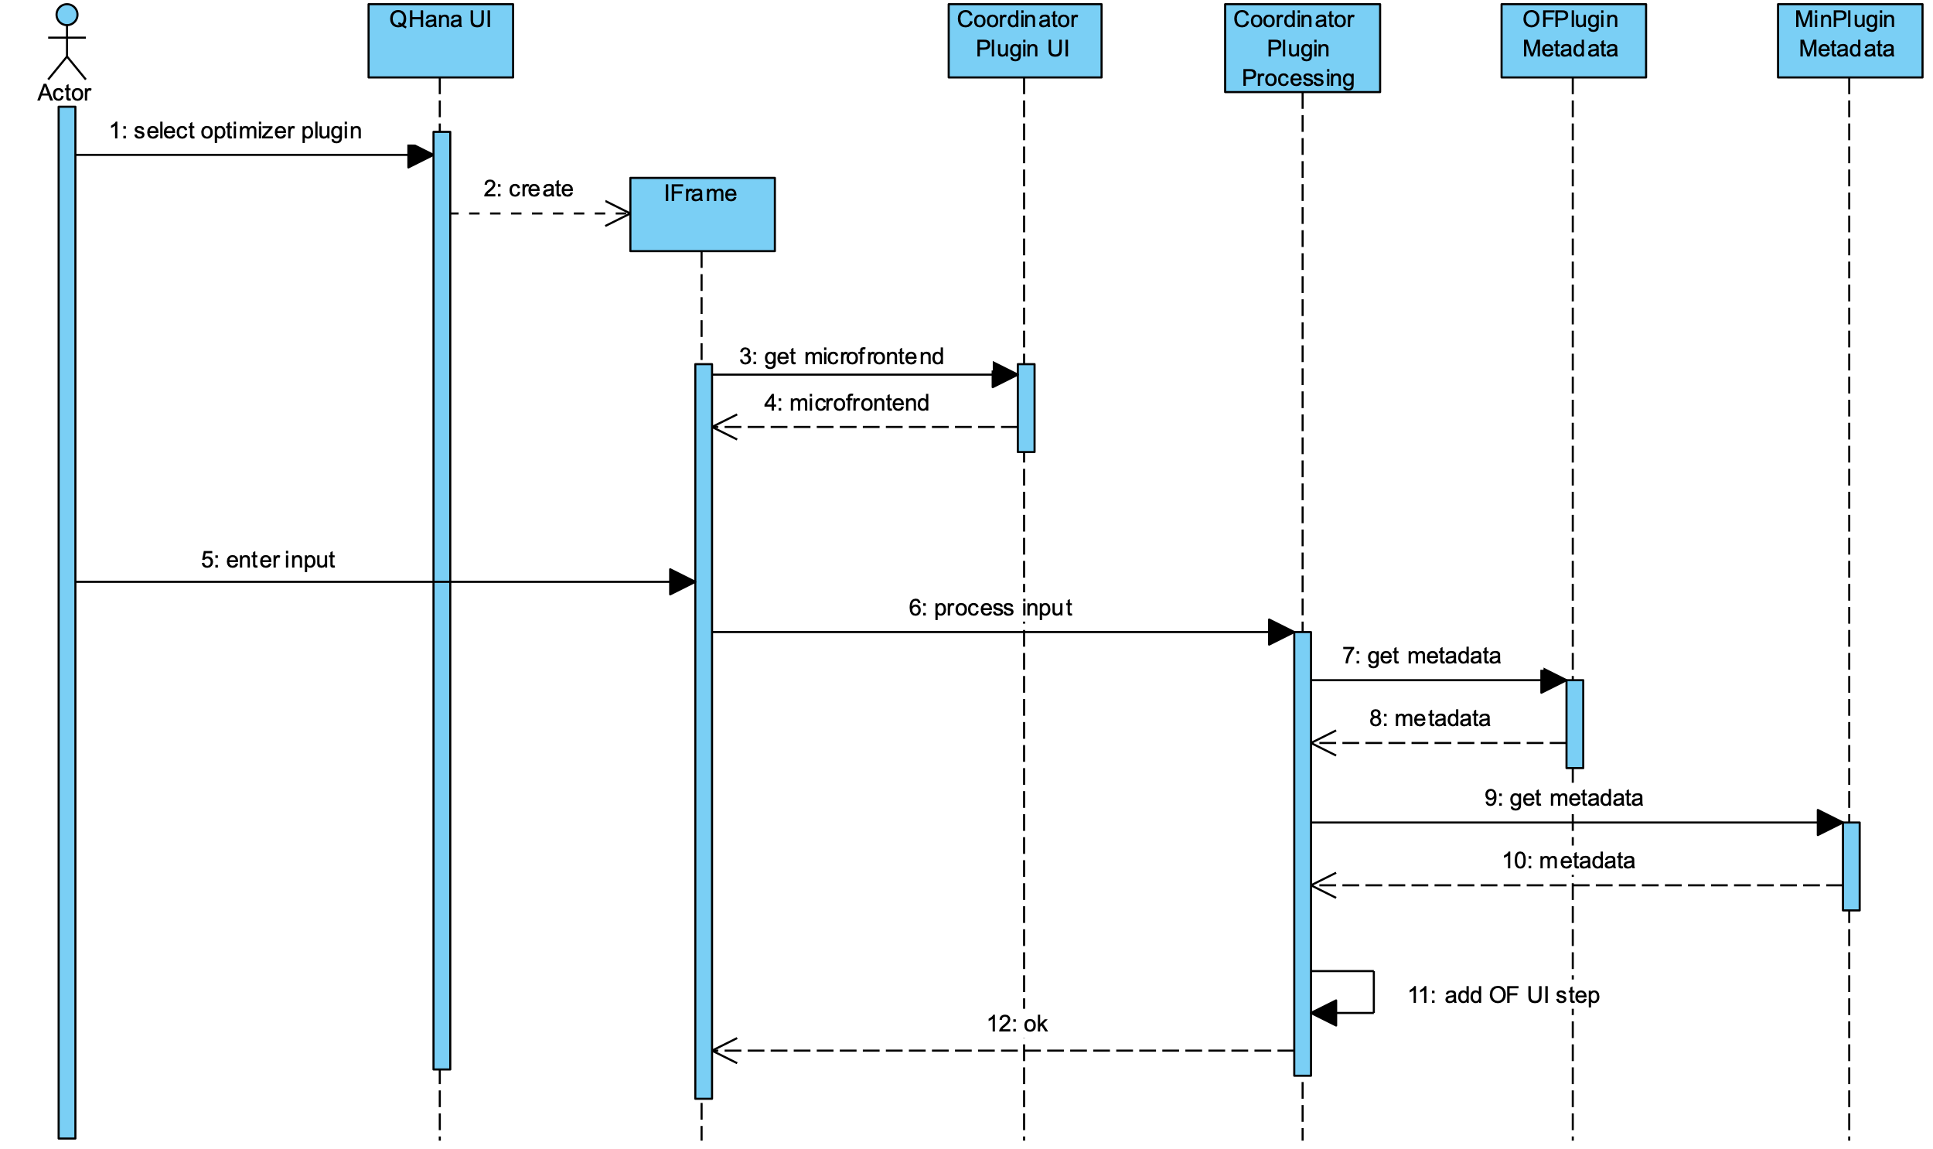
Architecture and Implementation Interaction Flow part 1

Slide 16
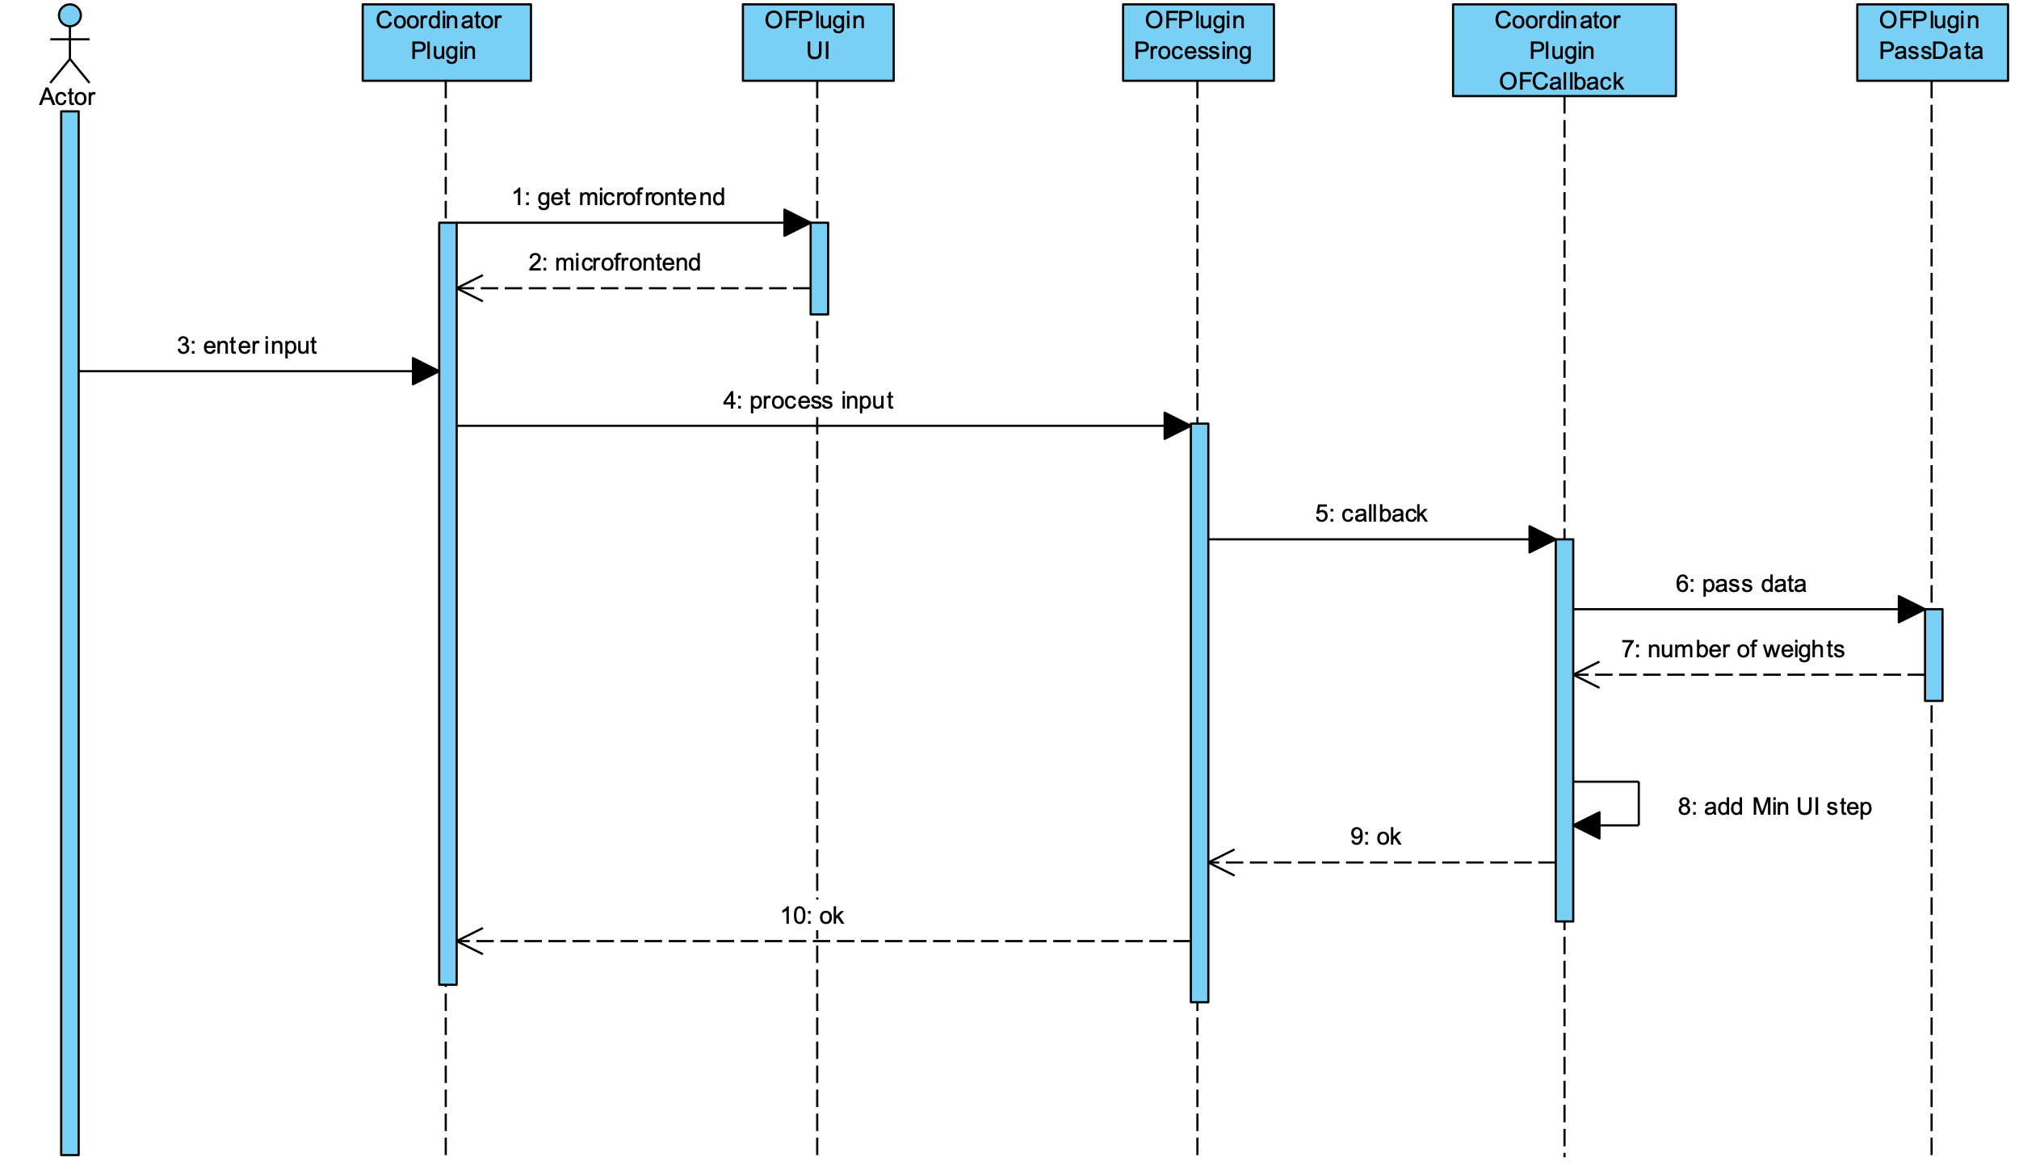
Architecture and Implementation Interaction Flow part 2

Slide 17
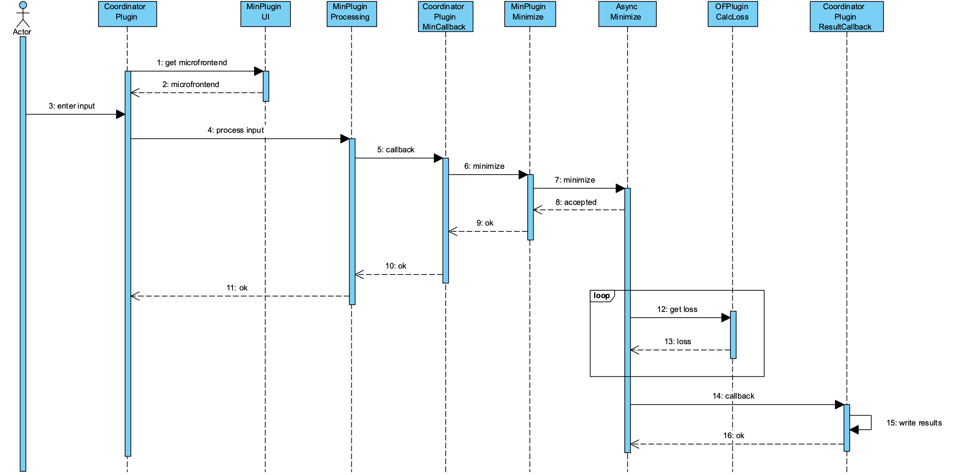
Architecture and Implementation Interaction Flow part 3

Slide 18
Architecture and Implementation 2 Approaches
Keep context between endpoints of a plugin
Explain database and task ids

Slide 19
Architecture and Implementation 2 Approaches
Graphic that shows difference between appraoches

Slide 20
Result Validation

Slide 21
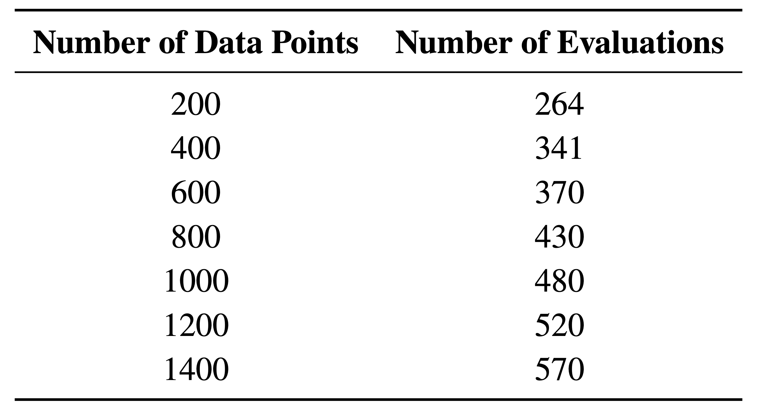
Performance Benchmarks
Compare 2 plugin-based implementatin appraoches
Jupyter Notebook implementation as ground truth comparison
Use different datasets with increasing number of data points and feature
Use ridge-loss and scipy plugins
Objective Function evaluation is main contributor to performance

Slide 22
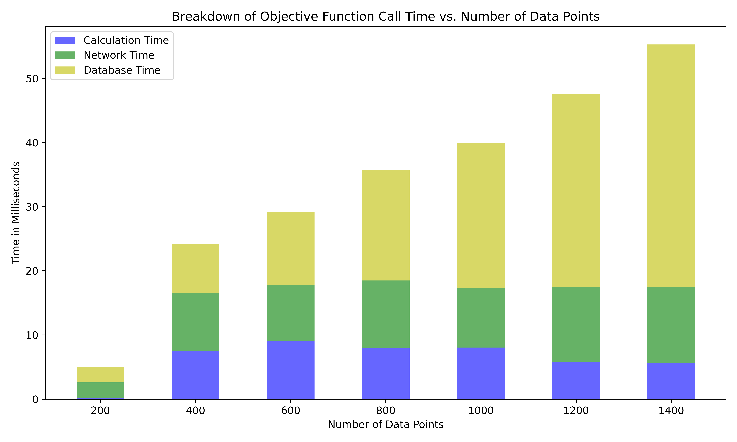
Performance Benchmarks
Time it takes for a single call to the calc_loss endpoint of the ridge-loss plugin for
different dataset sizes for the decoupled plugin-based implementation approach.

Slide 23
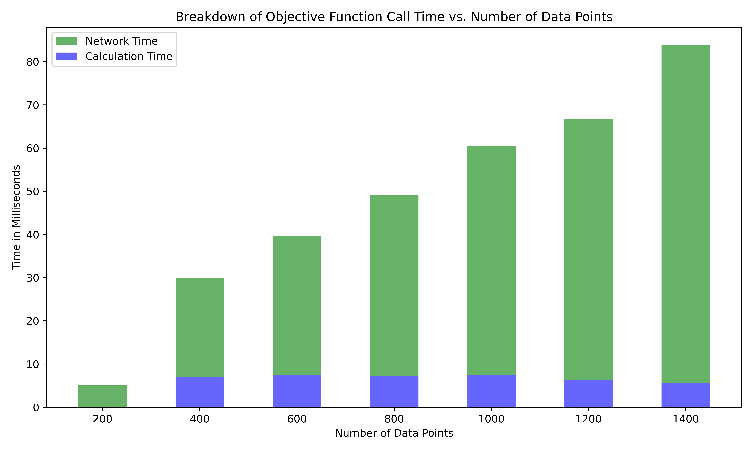
Performance Benchmarks
Time it takes for a single call to the calc_loss endpoint of the ridge-loss plugin for
different dataset sizes for the integrated plugin-based implementation approach.

Slide 24
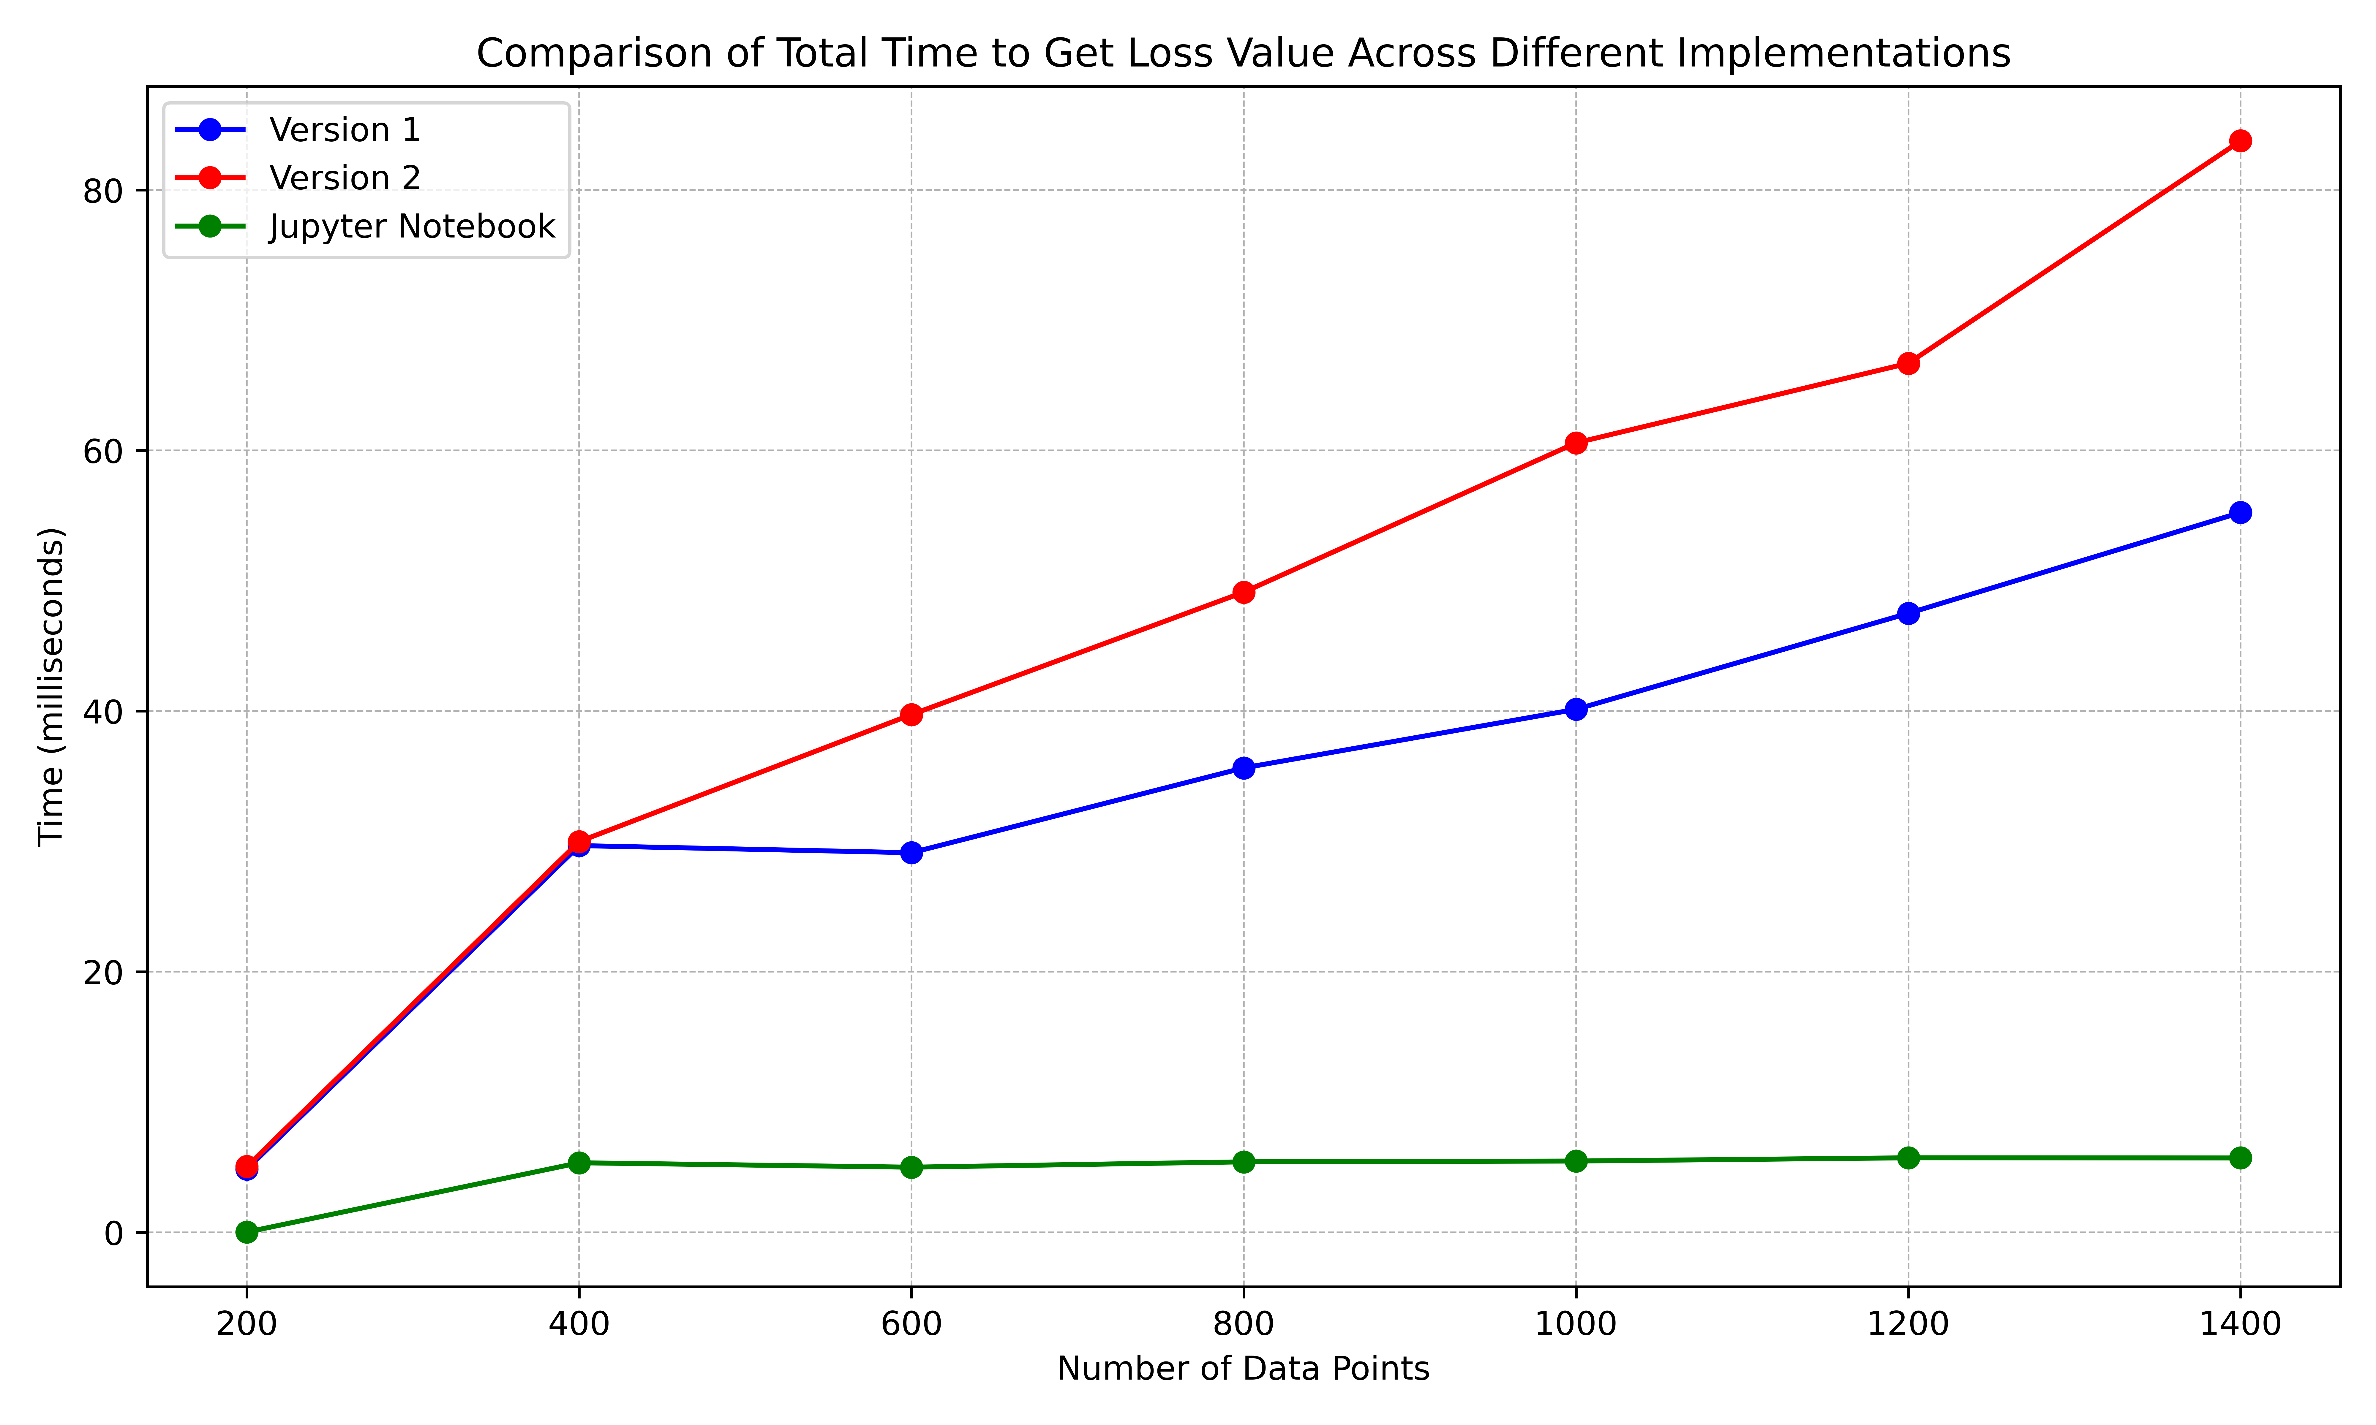
Performance Benchmarks
Comparison of the total time it takes to get the loss value across different implementations, including the Jupyter Notebook implementation.

Slide 25
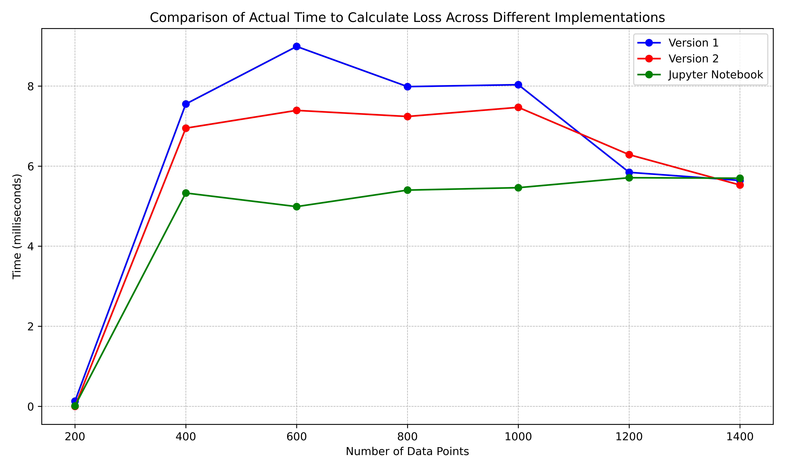
Performance Benchmarks
Comparison of the time the actual loss calculation takes across different implementations,
including the Jupyter Notebook implementation.

Slide 26
Problem: Overhead
Significant database and network latencies
Can not decrease network latency
Decoupled approach sends minimal data already
Integrated approach needs all the data on every call
Cache database lookups in decoupled approach (version 1)
Input and target data and hyperparameters do not change during minimization
Flask-Caching adds caching support for constant data
Only single call to database nescasarry, then data will stay in memory

Slide 27
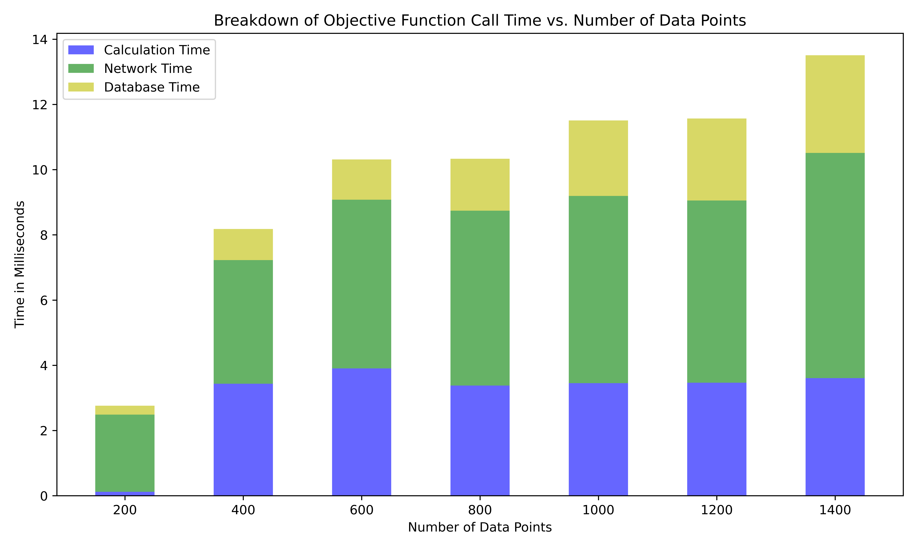
Performance Benchmarks witch Caching
Time it takes for a single call to the calc_loss endpoint of the ridge-loss plugin for
different dataset sizes with caching.

Slide 28
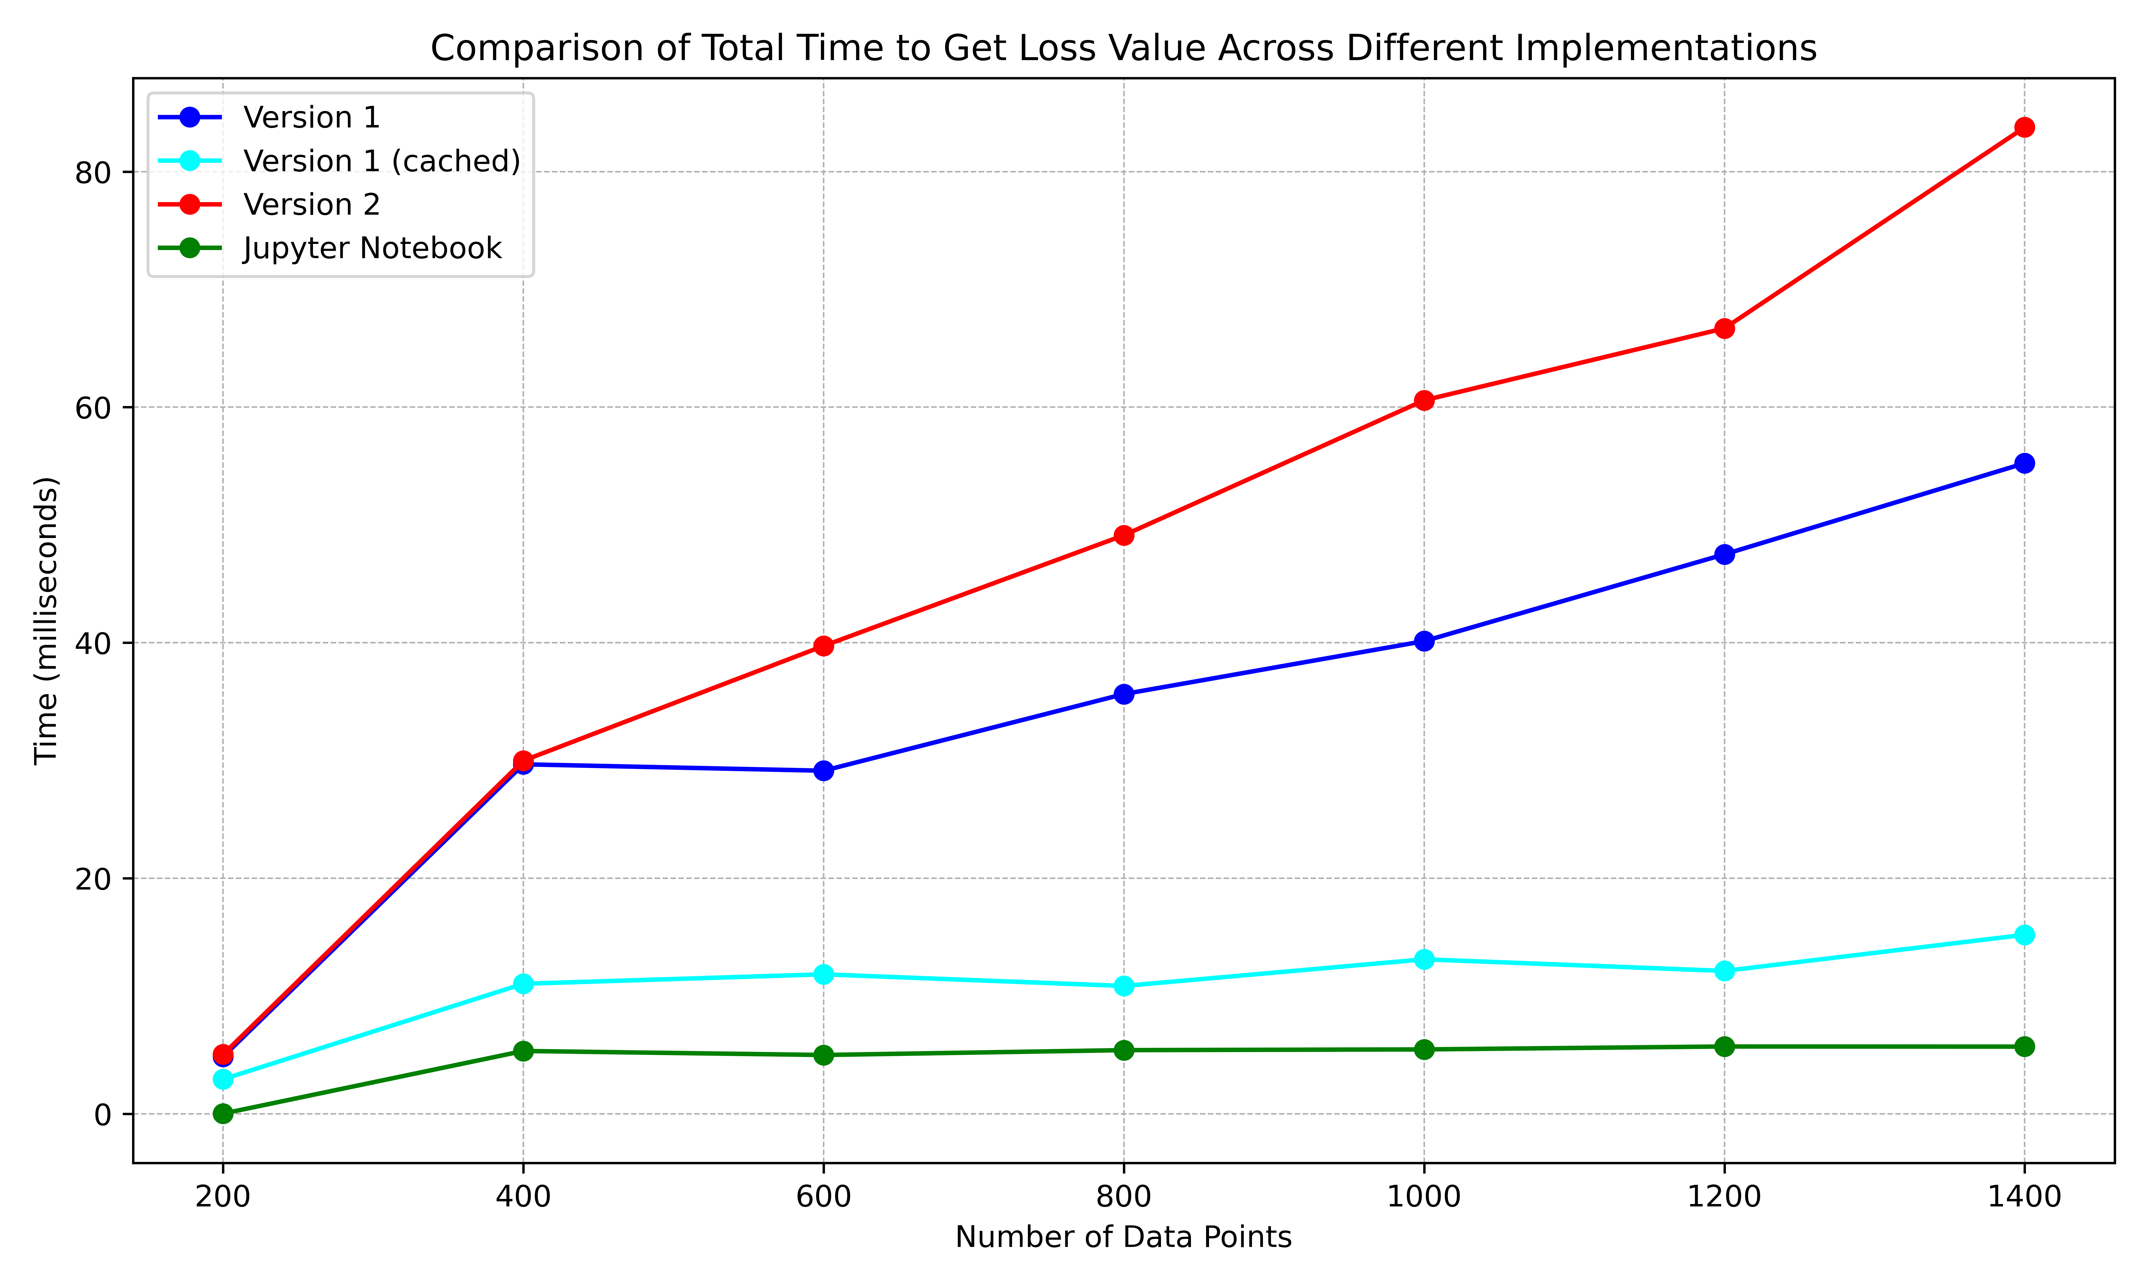
Performance Benchmarks witch Caching
Comparison of the total time it takes to get the loss value across different implementations, including a cached version of the first plugin-based implementation approach.

Slide 29
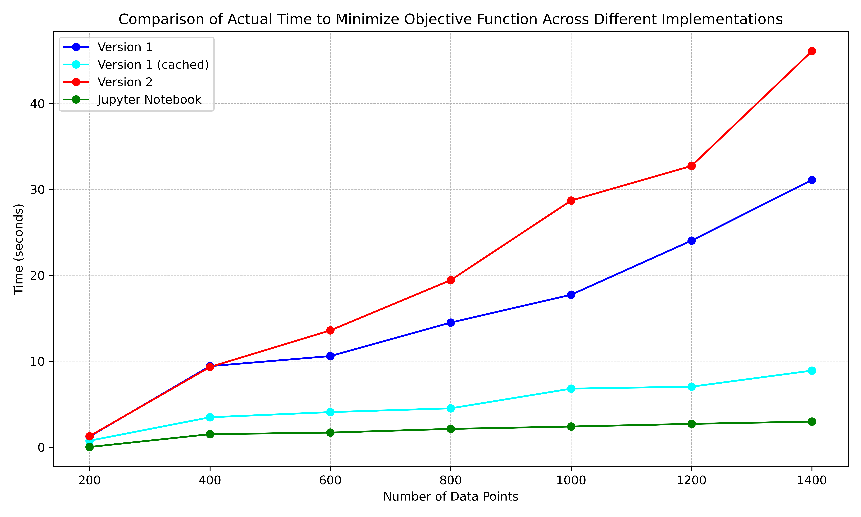
Performance Benchmarks witch Caching
Comparison of the total time it takes to complete the minimization process across
different implementations.

Slide 30
Performance Bencharks Conclusion
Compared 3 plugin-based approaches and a Jupyter Notebook implementation
Significant database and network latencies without caching
Caching significantly reduces database latencies
Network latency can not be further reduced
Decoupled approach with caching shows competetive performance
In context of VQAs the latencies deminish because of loss calucation times orders of magnitude longer

Slide 31
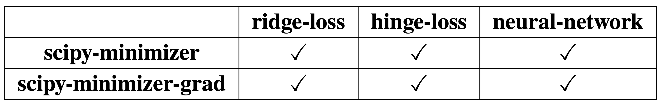
Interchangeability Results
Implemented different plugins with different functionalities
All plugins adhere to the proposed standards without a problem
Standards are designed to allow for interchangeability
New plugins can adhere to the standards
New plugins are interchangeable as well

Slide 32
Developer Experience

Slide 33
Conclusion and Outlook

Slide 34
Conclusion and Outlook

Slide 35
Thank you for listening. Any Questions?

